Slide 1
Chapter 5: Sequences & Discrete Diﬀerence Equations
(5.1) Sequences
(5.2) Limit of a Sequence
(5.3) Discrete Difference Equations
(5.4) Geometric & Arithmetic Sequences
(5.5) Linear Difference Equation with Constant Coefficients (scanned notes)

Slide 2
Sequences
1. (5.1) Sequences
Recall from Chapter 3 that bivariate data are often displayed as ordered pairs (x₁, y₁), (x₂, y₂), …, (x_{n}, y_{n}) or in a table:
A sequence is simply a particular kind of bivariate data set:
Or sometimes:
x | x₁ | x₂ | … | x_{n}
y | y₁ | y₂ | … | y_{n}
x | 1 | 2 | … | n
y | y₁ | y₂ | … | y_{n}
x | 0 | 1 | … | n-1
y | y₀ | y₁ | … | y_{n-1}

Slide 3
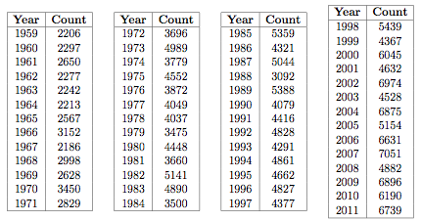
Example 5.1
1. (5.1) Sequences
Consider the following bivariate data set reflecting the total count of Northern Cardinals sighted in Tennessee at Christmastime:
If we think of the year data as “years starting with 1959”, then we have the following sequence:

Slide 4
Example 5.1
1. (5.1) Sequences
yrs start 1959 | 1 | 2 | 3 | 4 | 5 | 6 | 7 | 8
# birds | 2206 | 2297 | 2650 | 2277 | 2242 | 2213 | 2567 | 3152
yrs start 1959 | 9 | 10 | 11 | 12 | … | 51 | 52 | 53
# birds | 2186 | 2998 | 2628 | 3450 | … | 6896 | 6190 | 6739

Slide 5
Example 5.1
1. (5.1) Sequences
You may think of a sequence as simply an ordered list of numbers. That is, even though a sequence is a bivariate data set, the first member of each ordered pair is really just a placeholder:
The n^{th} term of the sequence.

Slide 6
Example 5.1
1. (5.1) Sequences
So then, as an ordered list, our previous data set looks like this:
(2206, 2297, 2650, 2277, 2242, 2213, 2567, 3152, 2186, 2998, 2628, 3450, 2829, 3696, 4989, 3779, 4552, 3872, 4049, 4037, 3475, 4448, 3660, 5141, 4890, 3500, 5359, 4321, 5044, 3092, 5388, 4079, 4416, 4828, 4291, 4861, 4662, 4827, 4377, 5439, 4367, 6045, 4632, 6974, 4528, 6875, 5154, 6631, 7051, 4882, 6896, 6190, 6739)
We don’t need to list the years explicitly since that information is “contained” implicitly in the ordering of the list.
We can find, for example, the number of cardinals seen in 1969 by finding the 11th term of the above sequence since 1969 is the 11th year starting with 1959. (2628)
Although this list is ordered, technically speaking, however, this list is not a sequence since it has only 53 terms. A sequence should have infinitely many terms.

Slide 7
Example 5.1
1. (5.1) Sequences
Let’s pretend for the moment that this (ordered) list does go on indefinitely. Can you tell what the 125th term is?
No. Since these are actual data measurements, there is no way to know in advance how many cardinals will be seen 2083.
If we build a model for this data, however, we would have a formula to determine the forecasted number of cardinals seen in year 2083.
This number would be the 125th term of a different sequence- namely, the sequence determined by the model.
Let’s use the skills from Unit 1 to find a least squares regression for this data.

Slide 8
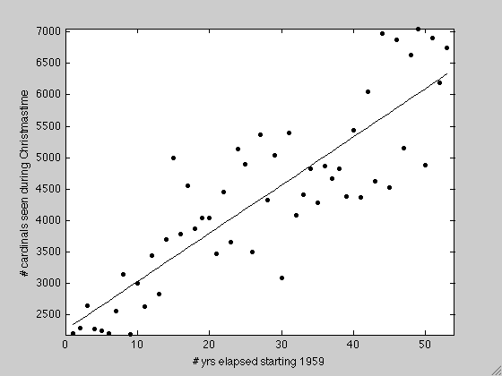
Example 5.1
1. (5.1) Sequences
Using our MATLAB program, we have:

Slide 9
Example 5.1
1. (5.1) Sequences
That is, we have a formula that determines a sequence. The number of cardinals N_{t} seen at Christmastime t years elapsed beginning in 1959 is forecast to be given by:
Again, this is not the “sequence” of the data but, rather, a LSR for the data. Interpolating for t=11, we get N(11)=3113. Notice this is different from our 11th data point, 2628.
But equipped with a formula that determines our sequence, we can extrapolate to find to the 125th term of our sequence:
To reinforce prior work: sometimes it is reasonable to assume a population is growing exponentially, so let’s rescale our data and see what we get:

Slide 10
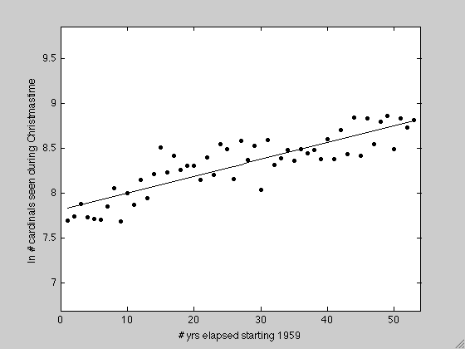
Example 5.1
1. (5.1) Sequences

Slide 11
Example 5.1
1. (5.1) Sequences
Once again, we have a formula that determines a sequence. The number of cardinals N_{t} seen at Christmastime t years elapsed beginning in 1959 is forecast to be given by:
Again, this is not the “sequence” of the data but, rather, a LSR for the data. Interpolating for t=11, we get N(11)=3039. Notice this is different from our 11th data point, 2628.
But equipped with a formula that determines our sequence, we can extrapolate to find to the 125th term of our sequence:

Slide 12
Example 5.2
1. (5.1) Sequences
Consider the sequence given by the formula:
Find the first 5 terms of this sequence.
Solution:

Slide 13
3. (5.3) Discrete Diﬀerence Equations
The formula in the previous example is an explicit formula in the following sense- if you want to know the 125th term of the sequence, you simply “plug in” 125 for n:
More common, however, when building models, we work with a recurrence formula or recurrence relation.
For example, consider a population that doubles each year. If we let x_{n} represent the size of the population at time step n, then we can model how this population changes from one time step to the next by the equation:

Slide 14
3. (5.3) Discrete Diﬀerence Equations
How is this different? Well, let’s consider how we would find the population size after 125 time steps:
So, in some sense, to find the 125th term, we need to know all of the previous terms. This is very different from the previous example.

Slide 15
Fibonacci Sequence
3. (5.3) Discrete Diﬀerence Equations
A famous example of a sequence generated by a recurrence relation is the Fibonacci sequence. Consider a population of rabbits. If we let x₀=1 and x₁=1, then the population size of the n^{th} generation of rabbits can be modeled by the recurrence relation:
Let’s generate some terms of the associated sequence:
We have: 1,1,2,3,5,8,13,21,? 34,55,89,144,…

Slide 16
Difference Equations
3. (5.3) Discrete Difference Equations
In general, suppose we have a quantity- like a population- whose value at time step n+1 depends on the values at each of the previous time steps. That is,
An equation that can be written in this form is called a difference equation. If the value at step n+1 depends only on the value at the previous step, that is, if:
then it’s a first order difference equation.
If the value at step n+1 depends on the values at the two previous steps, that is, if:
then it’s a second order difference equation.

Slide 17
3. (5.3) Discrete Difference Equations
As mentioned above, to find, say, the 125th term, we would need to know all of the previous terms:
Unless, that is, we can find an explicit formula for the n^{th} term that does not depend on any of the previous terms. In other words, we’d like to replace our recurrence formula with an “explicit” one:

Slide 18
Example 5.4
3. (5.3) Discrete Difference Equations
A population of doves increases by 3% each year. Let x_{n} be the size of the population at year n. Then:
Let x₀ be the initial population size. Then we have:

Slide 19
Geometric Sequences
4. (5.4) Geometric & Arithmetic Sequences
The example we just looked at was an example of a geometric sequence. A geometric sequence is a sequence with the form:
where a and r are numbers.
Notice that this sequence is generated by the form of that generic term. And the generic term, in this case, was found by solving the first order difference equation:

Slide 20
Example 5.5 (Wild Hares)
4. (5.4) Geometric & Arithmetic Sequences
A population of wild hares increases by 13% each year. Currently, there are 200 hares. If x_{n} is the number of hares in the population at the end of year n, find:
(a) the difference equation relating x_{n+1} to x_{n}
Solution: Since the population increases by 13% each year, the difference equation is:
(b) the general solution to the difference equation found in part a. Solution:
(c) the number of hares in the population at the end of six years from now. Solution:
Thus, at the end of year six there are approximately 416 hares.

Slide 21
Arithmetic Sequences
4. (5.4) Geometric & Arithmetic Sequences
Another common sequence is an arithmetic sequence. An arithmetic sequence is a sequence with the form:
where a and d are numbers.
Notice that this sequence is generated by the form of that generic term. And the generic term, in this case, is found by solving the first order difference equation:

Slide 22
Homework
Chapter 5:
5.2, 5.3, 5.5, 5.8, 5.9
Some answers:
5.5 (a) x_{n+1}=1.1x_{n} (b) x_{n}=50(1.1)^{n}
5.8 (a) x_{n}=800(1.1)^{n} + 200 (b) no (c) 68
5.9 (a) 5 (b) extinction

