Slide 1
Chapters 2 & 3 MATLAB Skills
This tutorial revisits Examples 3.1 to 3.4 to show how MATLAB can be used to solve the same problems
Scatter Plots
Other Simple Plots
Linear Regression
Interpolation & Extrapolation
Correlation Coefficients
Scripts

Slide 2
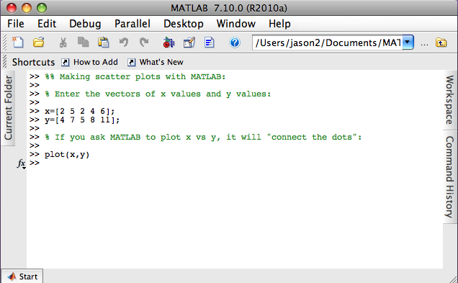
Scatter Plots
Chapters 2 & 3 MATLAB Skills

Slide 3
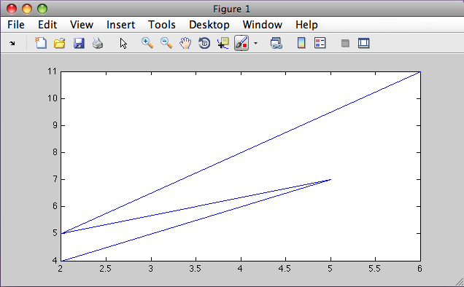
Scatter Plots
Chapters 2 & 3 MATLAB Skills

Slide 4
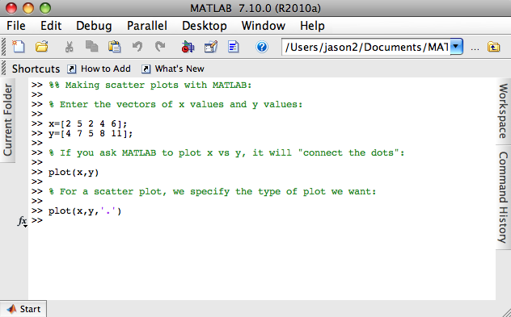
Scatter Plots
Chapters 2 & 3 MATLAB Skills

Slide 5
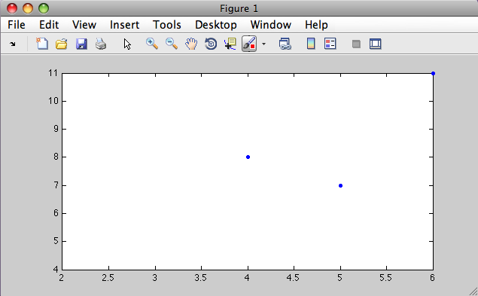
Scatter Plots
Chapters 2 & 3 MATLAB Skills

Slide 6
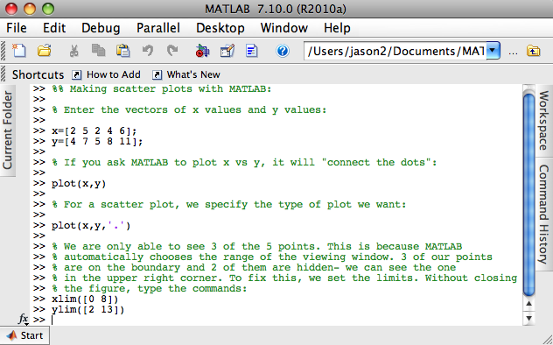
Scatter Plots
Chapters 2 & 3 MATLAB Skills

Slide 7
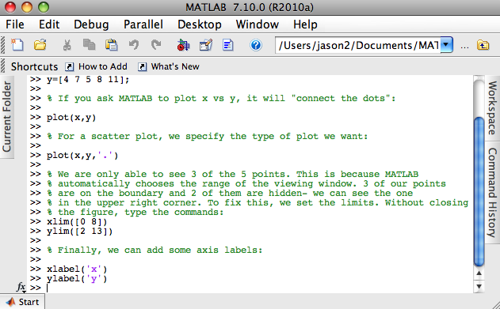
Scatter Plots
Chapters 2 & 3 MATLAB Skills

Slide 8
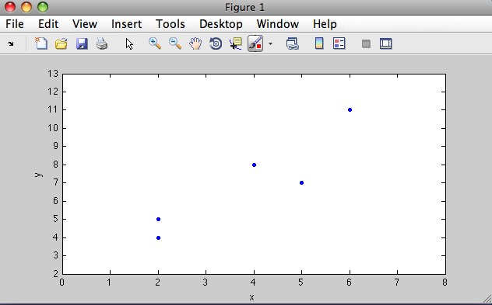
Scatter Plots
Chapters 2 & 3 MATLAB Skills

Slide 9
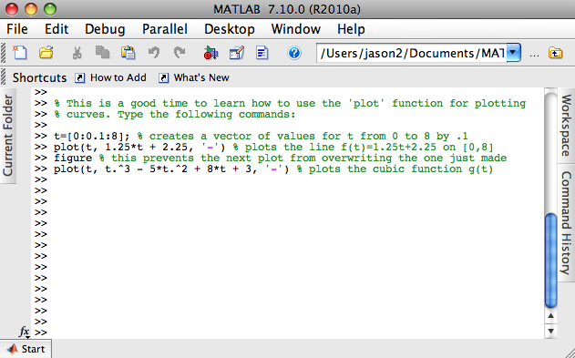
Other Simple Plots
Chapters 2 & 3 MATLAB Skills

Slide 10
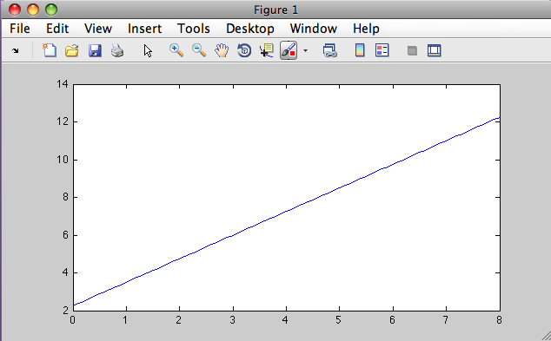
Other Simple Plots
Chapters 2 & 3 MATLAB Skills

Slide 11
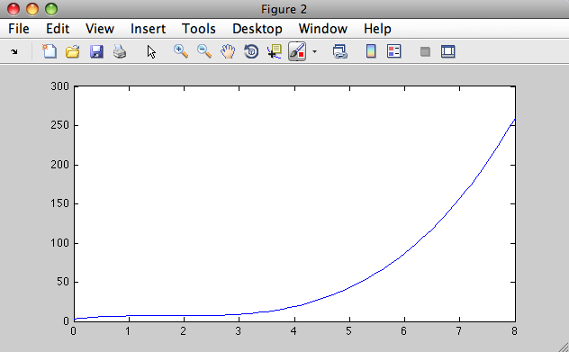
Other Simple Plots
Chapters 2 & 3 MATLAB Skills

Slide 12
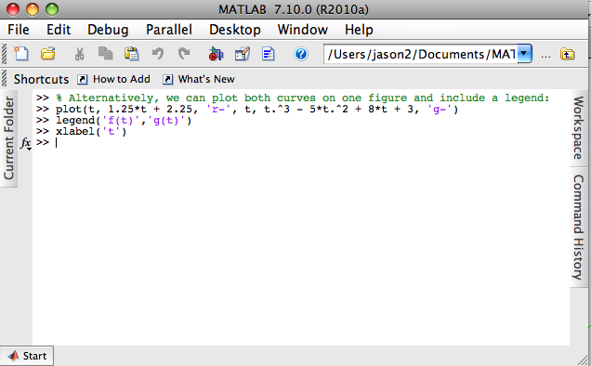
Other Simple Plots
Chapters 2 & 3 MATLAB Skills

Slide 13
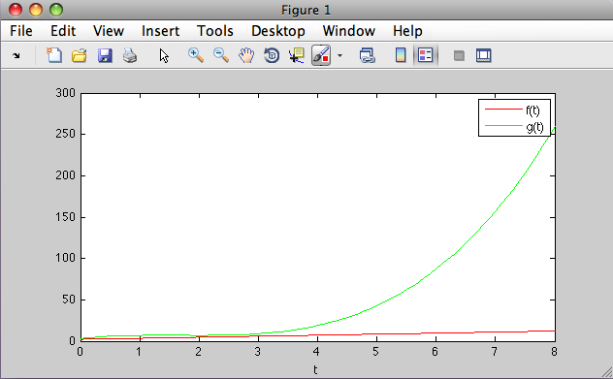
Other Simple Plots
Chapters 2 & 3 MATLAB Skills

Slide 14
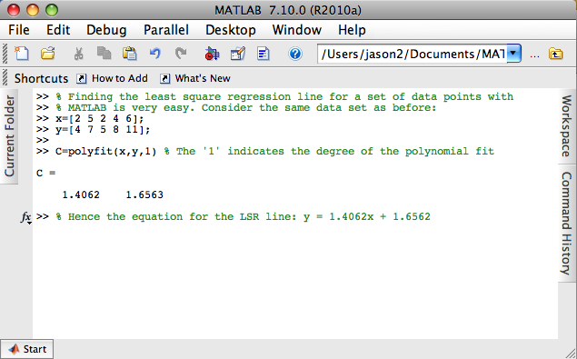
Linear Regression
Chapters 2 & 3 MATLAB Skills

Slide 15
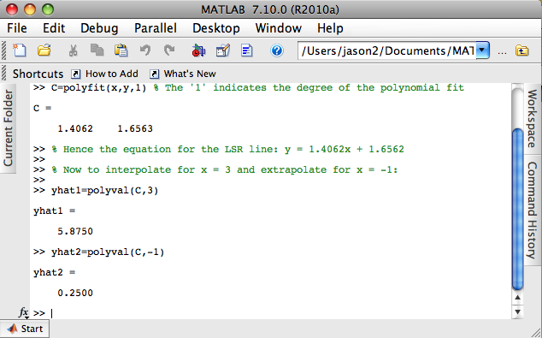
Interpolation & Extrapolation
Chapters 2 & 3 MATLAB Skills

Slide 16
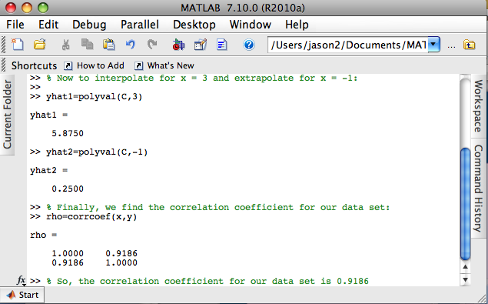
Correlation Coefficient
Chapters 2 & 3 MATLAB Skills

Slide 17
Scripts
Chapters 2 & 3 MATLAB Skills
Rather than typing commands into the Command Window, it is often useful to create a script that Matlab executes all at once.
As an exercise, familiarize yourself with the steps for creating and running script files. Use Appendix A.4 of your textbook as a guide. (In the book, script files are called m-files; this is because MATLAB executable files end with .m
Now, write and run the script file that covers the material we just went through
You can find this script on pages 52-53 of the text

